Slide 1

Design Of Planar Monople Antenna For Wireless and Energy Harvesting Applications
UNDER THE GUIDENCE OF
Dr.AMIT KUMAR VARSHNEY,
Associate Professor,
Department of
ELECTRONICS AND
COMMUNICATION ENGINEERING
TEAM MEMBERS:
DUGGINENI BHANU PRAKASH 212220060042
CHEMIRTHIPALLI GIRISH 212220060034

Slide 2
ABSTRACT
A planar circular monopole antenna with slots in the patch as well as in the ground plane is presented. Slots of different shapes and sizes are etched in patch and ground plane to bring down the resonant frequency of proposed antenna and increase its bandwidth
This paper presents the design, simulation, and optimization of a broadband planar antenna tailored for wireless applications requiring point-to-point communication.
The proposed broadband planar antenna design offers a versatile solution for wireless applications requiring point-to-point communication. Through careful optimization and simulation-driven design, the antenna achieves remarkable bandwidth, gain, and radiation properties.
This work contributes to the advancement of wireless communication systems by providing a reliable and efficient antenna option for establishing robust connections between distant points. Further experimental validation and integration into practical communication setups are recommended for a comprehensive assessment of the antenna's performance in real-world scenarios.

Slide 3
INTRODUCTION
Owing to the emergence of several wireless standards and protocols it has become necessary to design an antenna that can operate in multiple frequencies. This calls for broad banding an antenna.
A planar monopole antenna is inherently broadband because it is evolved from microstrip patch antenna by increasing the substrate height and decreasing the permittivity of substrate since both height and permittivity of the substrate have direct affect on the bandwidth.
For planar monopole antenna ground plane can be thought to be at infinity and permittivity close to 1 (air substrate)
Increasing the thickness of the monopole further increases the bandwidth. At the design frequency, the monopole antennas should be a quarter of a wavelength long. If the radius of the cylinder is made thicker, the bandwidth of the antennas can be increased.
The advancement of current world technology, as well as customer demand for multiple services offered by a single wireless device, has influenced the need for an antenna capable of transmitting and receiving electromagnetic waves across multiple frequency bands.
In this paper the authors have proposed a novel broadband planar monopole antenna that will cover simultaneously a number wireless standards and protocols (especially the standards at low frequencies) so that the proposed antenna can be used in wireless as well as energy harvesting applications.

Slide 4
PROBLEM STATEMENT
To design planar fat monopole antenna and optimize the length and breadth of monopole and the ground plane so as to increase its bandwidth. There may be slots and/slits in monopole as well as ground plane so as to reject some specific frequencies

Slide 5
LITERATURE REVIEW
Title of Paper | Algorithm Used | Advantages / Disadvantages
"Design of Compact Dual-Band Antenna for IoT and RFID" | Genetic Algorithm (GA) | Advantages: Dual-band operation, suitable for IoT and RFID applications. Disadvantages: Limited frequency agility.
"A Compact Planar Monopole Antenna for IoT Applications" | Particle Swarm Optimization (PSO) | Advantages: Compact size, impedance matching, suitable for IoT. Disadvantages: Single-band operation.
"Wideband Planar Monopole Antenna for 5G Communication" | Finite-Element Method (FEM) | Advantages: Wideband operation for 5G, good gain. Disadvantages: Complex geometry, limited multiband capability.
"A Miniaturized Multiband Antenna for Energy Harvesting" | Genetic Algorithm (GA) | Advantages: Multiband operation, energy harvesting capability. Disadvantages: Smaller bandwidth, reduced gain.
"Design of a Dual-Band Monopole Antenna for Wi-Fi and WiMAX" | Particle Swarm Optimization (PSO) | Advantages: Dual-band operation, suitable for Wi-Fi and WiMAX. Disadvantages: Limited bandwidth.
"Planar Monopole Antenna for Energy Harvesting in RF Bands" | Analytical Design | Advantages: Optimized for energy harvesting, simple design. Disadvantages: May lack communication efficiency.

Slide 6
EXISTING SYSTEM
There were various existing methods and techniques for designing broadband planar antennas for wireless applications, particularly for point-to-point communication. Some of these methods include:
Microstrip patch antennas are commonly used for designing broadband planar antennas due to their compact size and ease of integration. Various feeding techniques, such as inset-fed, microstrip line-fed, and aperture-coupled feeding, have been employed to achieve wide bandwidth.
Proximity Coupled Feed This technique involves placing a feed element close to the radiating patch, allowing for improved bandwidth and impedance matching. It's often used to enhance the antenna's bandwidth and performance.
Antennas involve coupling the radiating element to a microstrip line through an aperture. This technique helps in achieving wider bandwidth and better impedance matching.
HFSS can be integrated into the antenna design to enhance its performance and achieve broadband characteristics. These surfaces can be used to control radiation patterns and impedance across a wide frequency range.

Slide 7
PROPOSED SYSTEM
A simple circular monopole antenna is designed and simulated in simulation software . One side of the substrate consists of circular monopole with microstrip line (top side) and the other side (bottom side) consists of only ground plane.
The substrate used is FR4 epoxy having relative permittivity ε_{r}=4.4 and thickness h=1.6mm. The dimensions are optimized for better impedance matching. The initial length of monopole is obtained using the available analytical formulation available in literature
The length of the wire monopole antenna is quarter-wave long at the design frequency with some correction factor. With increase in the thickness of the radius of the wire, the bandwidth increases. So for broadband monopole antenna the lower frequency corresponding to VSWR=2 or S₁₁=-10dB can be calculated by equating the area of the radiating structure with the equivalent cylindrical monopole antenna having the same height as that of original antenna.

Slide 8
PROPOSED SYSTEM – BLOCK DIAGRAM
Simulation of simple planar monopole antenna at 2.4GHZ(narrow band)
Simulation and optimization of fat circular planar monopole antenna with centre frequency at 2.4GHZ(Broadband)
Cutting Slots/Slits in the ground plane and patch for introduction of notch in the frequency response and bandwidth enhancement at lower frequency
After optimization of size and shapes of slots in simulation software the designed antenna is fabricated
Fabricated antenna parameters measured using pocket VNA

Slide 9
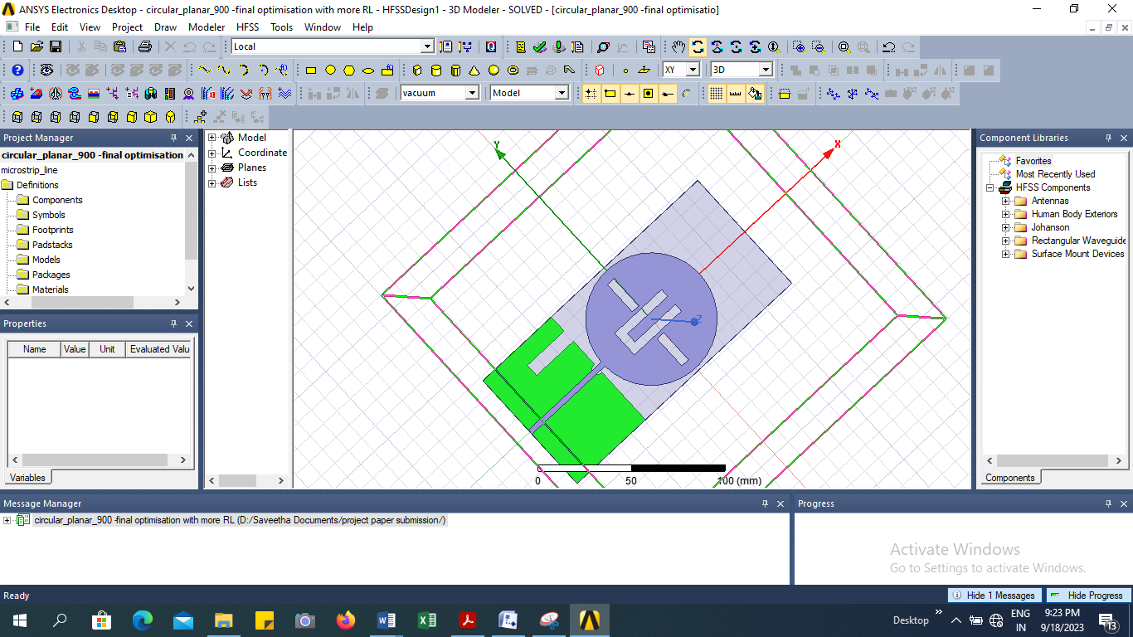
PROPOSED SYSTEM – BLOCK DIAGRAM

Slide 10
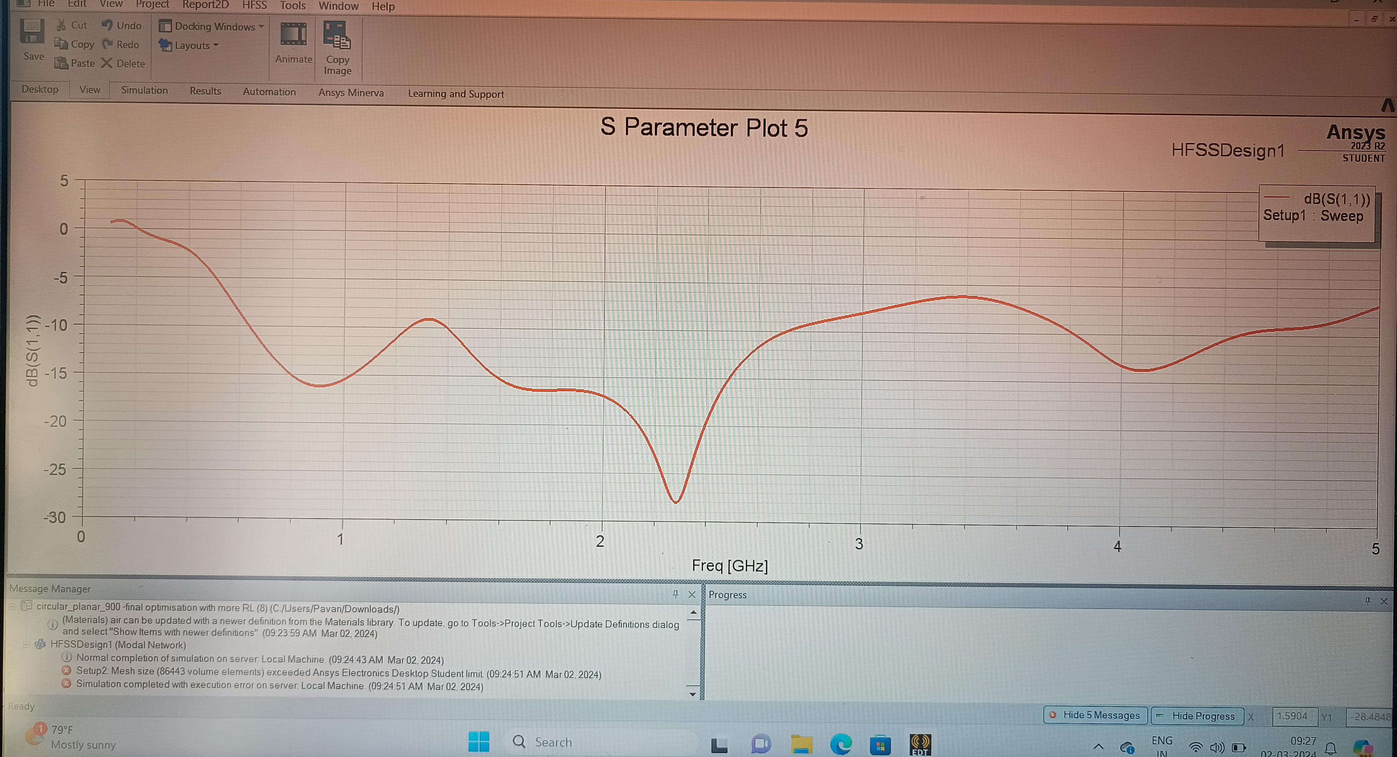
RESULTS:

Slide 11
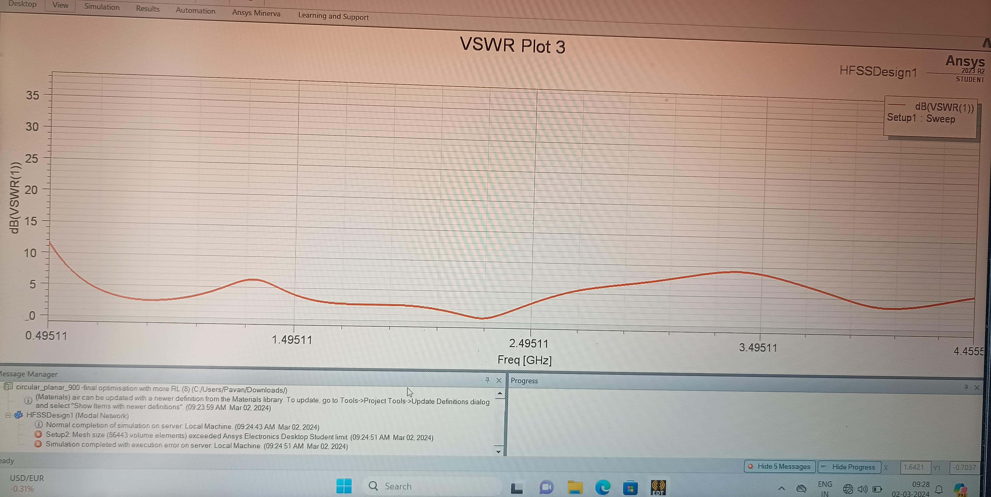
RESULTS:

Slide 12
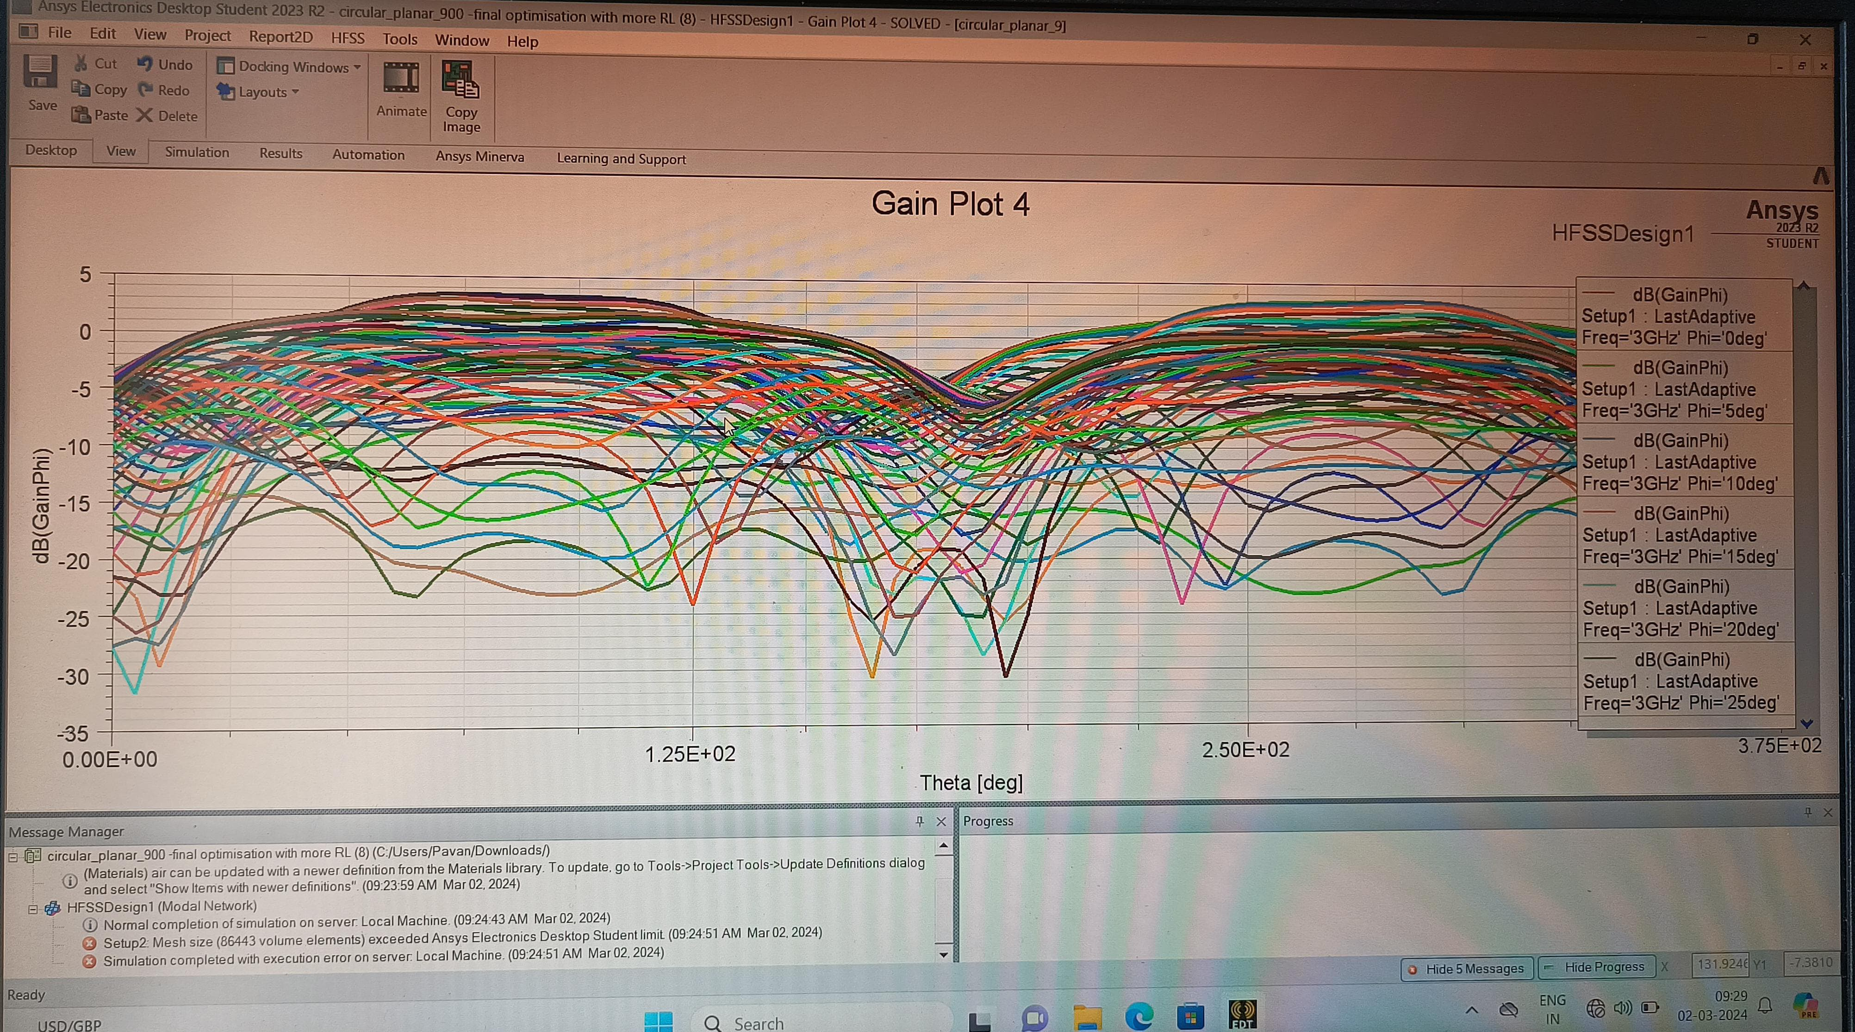
RESULTS :

Slide 13
CONCLUSION
A simple circular monopole antenna provides high bandwidth.
The lower cutoff frequency of the monopole antenna can be lowered by cutting lots in the radiating patch and/or ground plane, however doing such also introduces some band of frequencies where the S₁₁ parameter deteriorates.
The proposed antenna finds application in wireless standards like Wifi, WiMAX, Bluetooth, RFID, GPS etc. and also finds application in energy harvesting.

Slide 14
REFERENCES
John D Kraus, Ronald J Marhefka and Ahmad S Khan, Antennas and Wave Propagation, Fifth Edition, McGraw Hill Education Pvt. Ltd., 2018.
C. A. Balanis, Antenna Theory Analysis and Design, pp.728-730, John Wiley & Sons, 2nd Edition.
Girish Kumar and K P Ray, Broadband Microstrip Antennas, Artech House Boston • London, pp. 361.
S.De, S.Sarkar, S.Biswas, D.Sarkar and P.P.Sarkar “Investigation on broadband microstrip two element monopole antenna with high gain” IETE Journal of Research, Vol.59, Issue.4, Pp.400-403,2013.
S. De and P.P. Sarkar “A High Gain Ultra-wideband Monopole Antenna” International Journal of Electronics and Communications (AEÜ). Vol.69, Pp.1113-1117, 2015.
S.De, S.Sarkar, S.Biswas, D.Sarkar and P.P.Sarkar “Investigation on broadband microstrip two element monopole antenna with high gain” IETE Journal of Research, Vol.59, Issue.4, Pp.400-403,2013.
S. De and P.P. Sarkar “A High Gain Ultra-wideband Monopole Antenna” International Journal of Electronics and Communications (AEÜ). Vol.69, Pp.1113-1117, 2015.

Slide 15
THANK YOU

